Slide 1

Sales analysis for the Kaufland retail chain
Individual project on Business Intelligence
Prepared by: Vesela Yavorova Krumova
Faculty number: 521324016

Slide 2
Content
01
04
02
05
03
Introduction to the topic and the challenges of analysis
General Dashboard: vision and features
Data description and organization
Analysis results and conclusions
Visualization of the data model

Slide 3
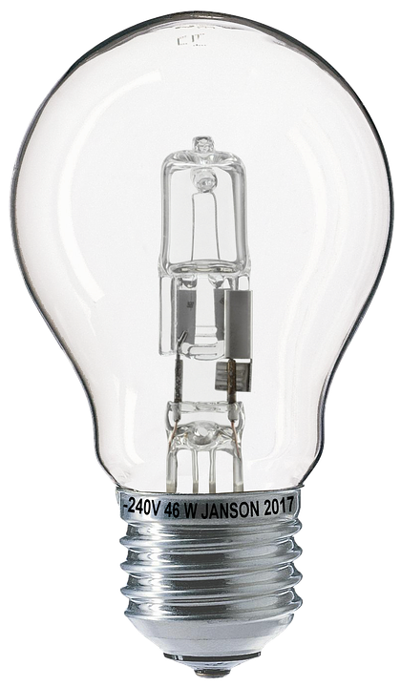
Introduction to the topic and the challenges of analysis
The project "Sales analysis in the Kaufland retail chain" aims to derive key insights into Kaufland's business performance through business intelligence. The idea is to generate data through tables that collectively reflect the analysis of sales information in the various stores of the chain, using the relevant metrics and data sources related to categories to the products themselves, regions (stores), periods, and other important aspects of the retail activity.

Slide 4
Introduction to the topic and the challenges of analysis
The project will use the methods of Business Intelligence, which are related to linking data tables (such as products, sales, customers, transactions etc.) through relations and corresponding key indicators. In addition, reports, visualizations in the form of charts and statistics will be generated using special QlikView software that will demonstrate the workload of different products or stores over time.

Slide 5
Introduction to the topic and the challenges of analysis
These data will be used to analyse the following key questions:
Which categories of products are the best sellers and therefore what is the best selling product and which category does it belong to?
What is the difference in sales between large hypermarkets (in big cities) and smaller stores in the Kaufland network?
What are the trends in Kaufland's food versus non-food items?
What are the seasonal patterns in Kaufland's sales?
Which are the leading regions by sales in the first month and what are their shares in total sales?

Slide 6
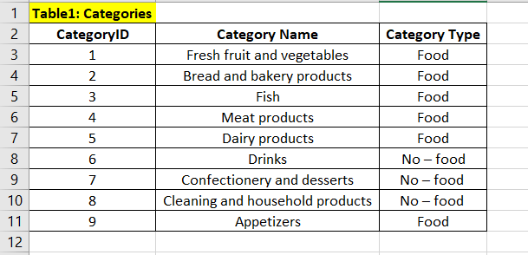
Data description and organization
The data contains the following tables, each organized in separate sheets of an Excel file:
Table 1: Categories
CategoryID: Unique identifier for each category (Primary key)
Category Name: Name of the category Category Type: Type of category

Slide 7
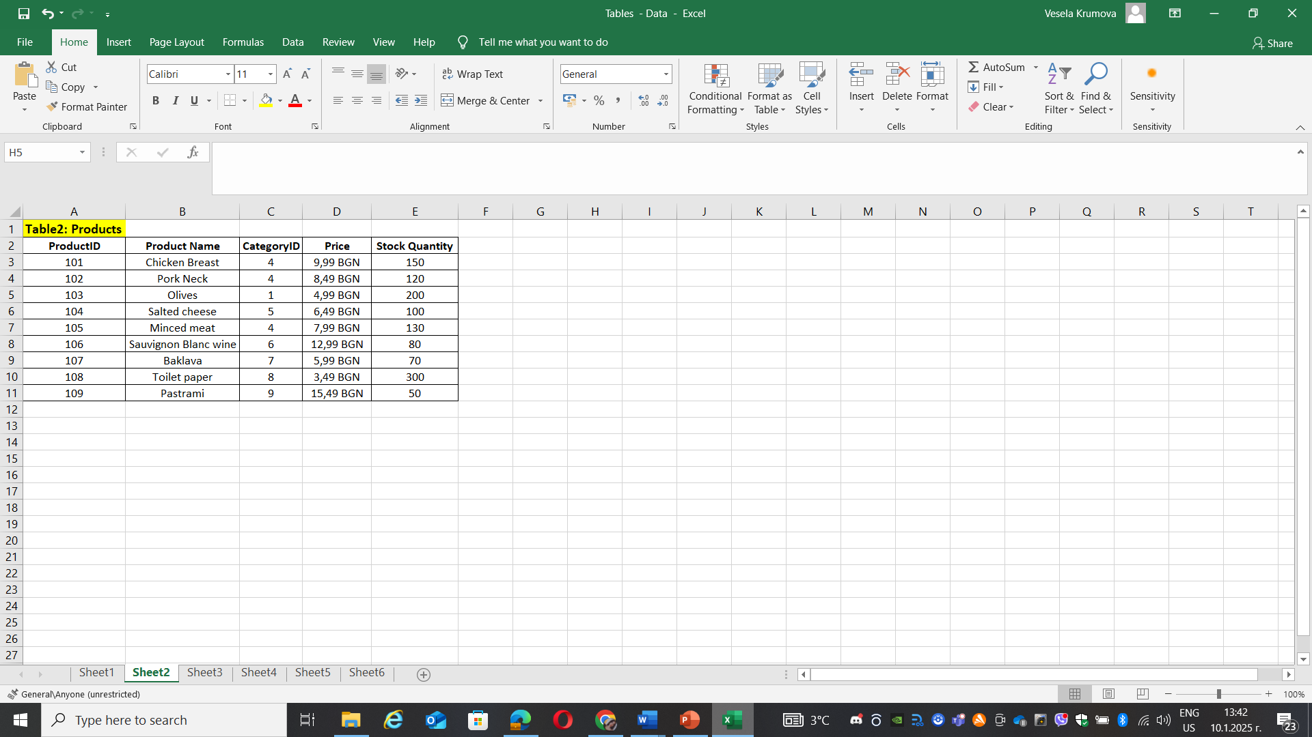
Data description and organization
The data contains the following tables, each organized in separate sheets of an Excel file:
Table 2: Products
ProductID: Unique identifier for each product (Primary Key)
Product Name: Product name
CategoryID: Refers to the CategoryID from the Categories table (Foreign Key)
Price: Product price
Stock Quantity: Product availability

Slide 8
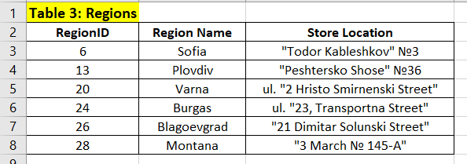
Data description and organization
The data contains the following tables, each organized in separate sheets of an Excel file:
Table 3: Regions
RegionID: Unique identifier for the region (Primary Key)
Region Name: Name of the region
Store Location: Address or location of the store

Slide 9
Data description and organization
The data contains the following tables, each organized in separate sheets of an Excel file:
Table 4: Stores
StoreID: Unique identifier for stores (Primary Key)
Store Name: Store name
RegionID: Refers to RegionID from the Region table (Foreign Key)
Store Type: Store type
Sales (Month 1-3): Sales in the first three months
Sales (Seasonal): Seasonal sales
ProductID: Refers to ProductID from the Products table (Foreign Key)
Seasonal Trend: Sales trends during the season

Slide 10
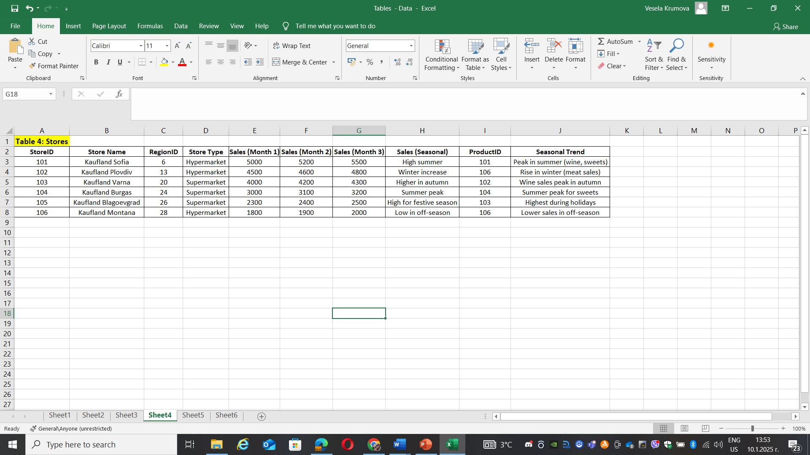

Slide 11
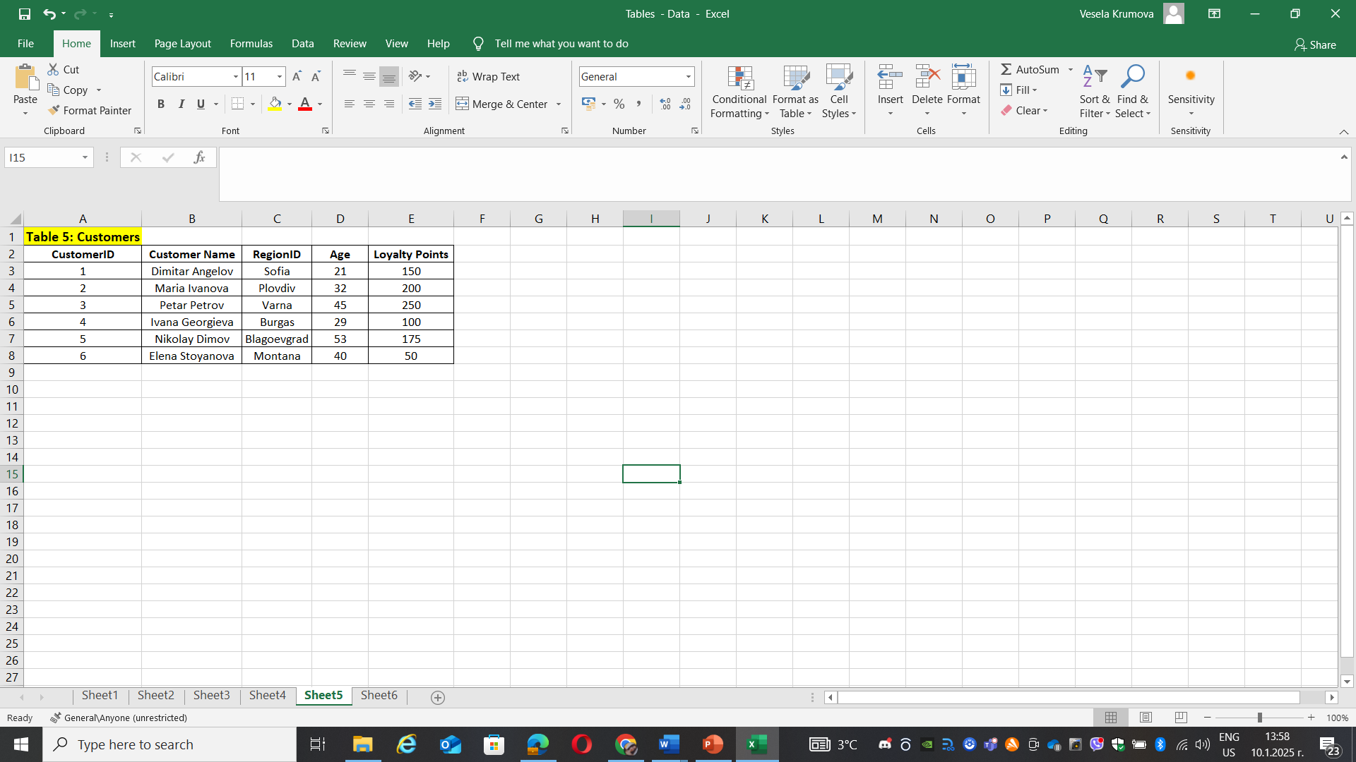
Data description and organization
The data contains the following tables, each organized in separate sheets of an Excel file:
Table 5: Customers
CustomerID: Unique identifier for each customer (Primary Key)
Customer Name: Customer name
RegionID: Refers to RegionID from the Region table (Foreign Key)
Age: Customer age
Loyalty Points: Customer loyalty points

Slide 12
Data description and organization
The data contains the following tables, each organized in separate sheets of an Excel file:
Table 6: Transactions
TransactionID: Unique identifier for each transaction (Primary Key)
CustomerID: Refers to CustomerID from the Customers table (Foreign Key)
StoreID: Refers to StoreID from the Stores table (Foreign Key)
ProductID: Refers to ProductID from the Products table (Foreign Key)
Quantity: Quantity of product purchased
Date: Date of transaction
Total Price: Total amount for the transaction

Slide 13
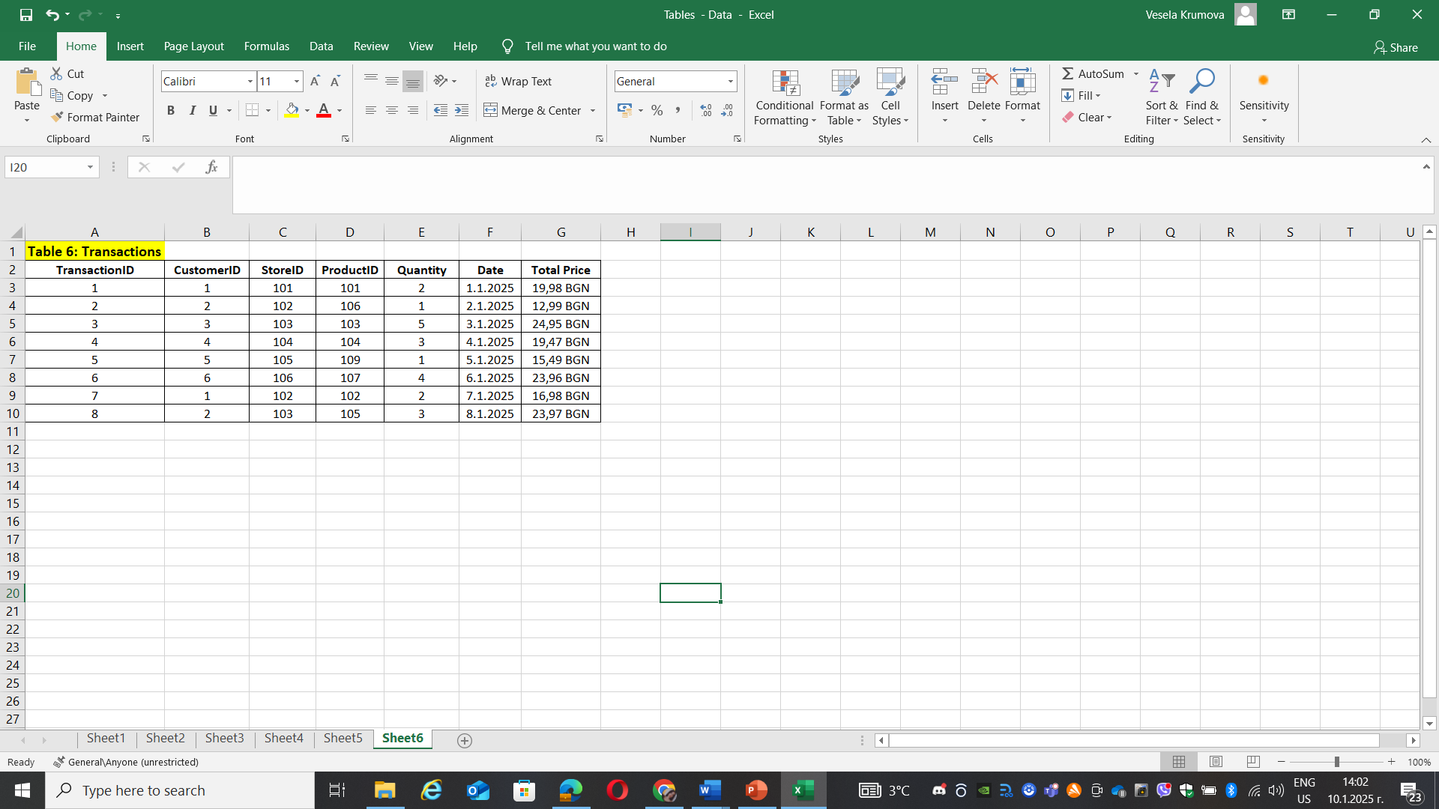

Slide 14
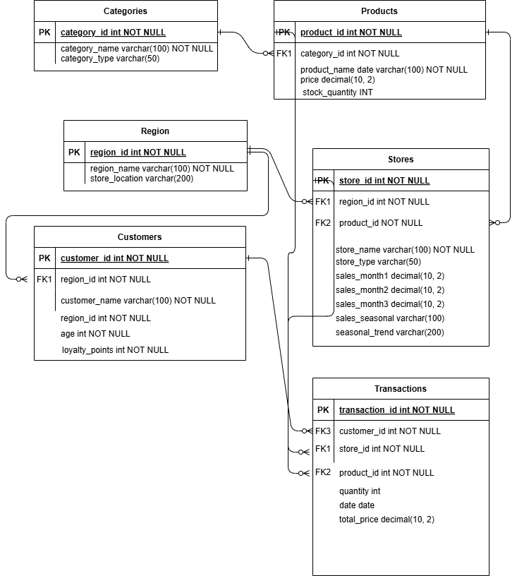
Visualization of the data model
Relational model:
CategoryID links Categories and Products.
RegionID links Region, Stores and Customers.
StoreID and ProductID link Transactions to Stores and Products.
CustomerID links Transactions and Customers.

Slide 15
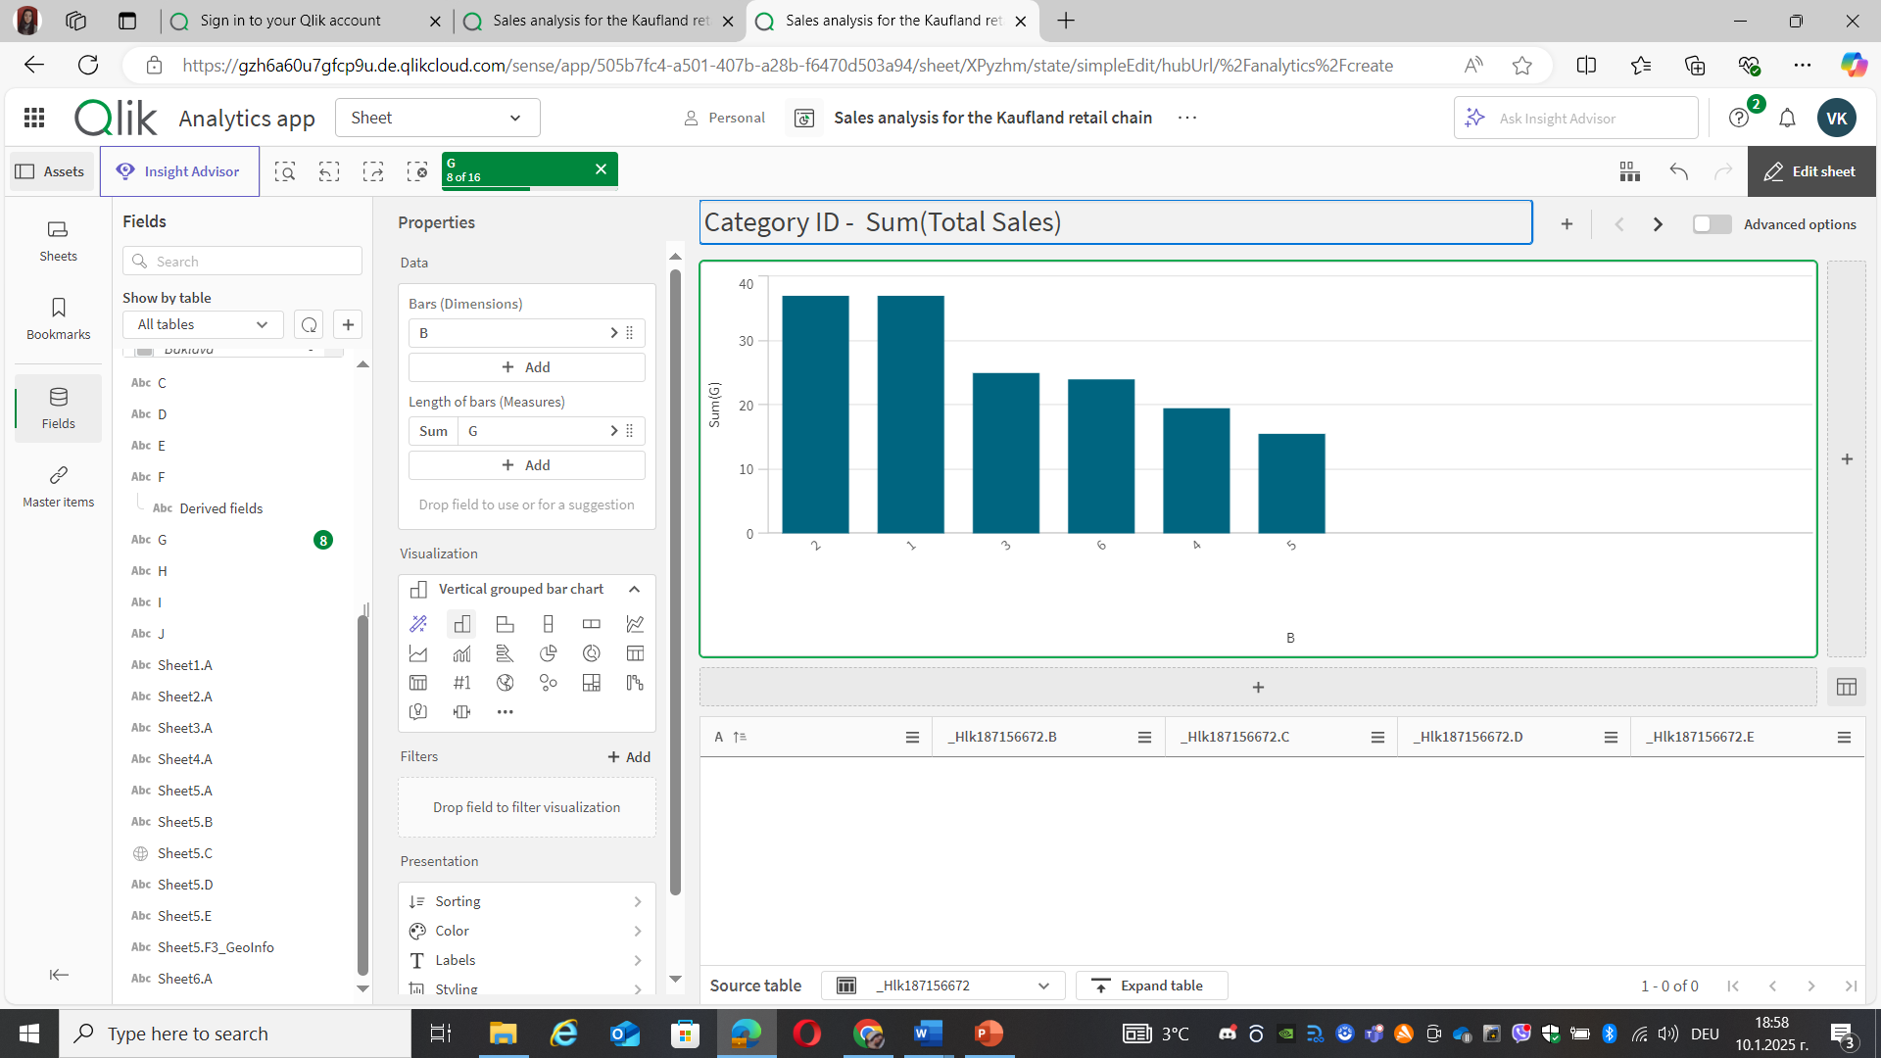
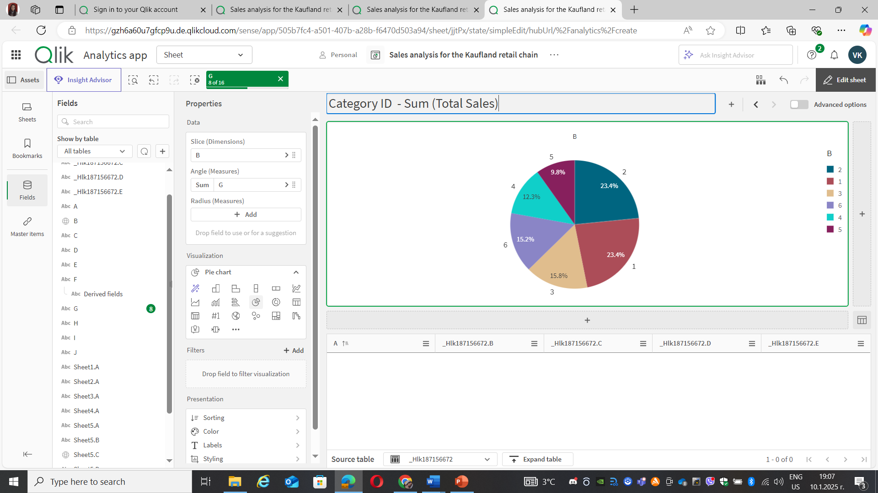
General Dashboard: vision and features
Best sellers by category

Slide 16
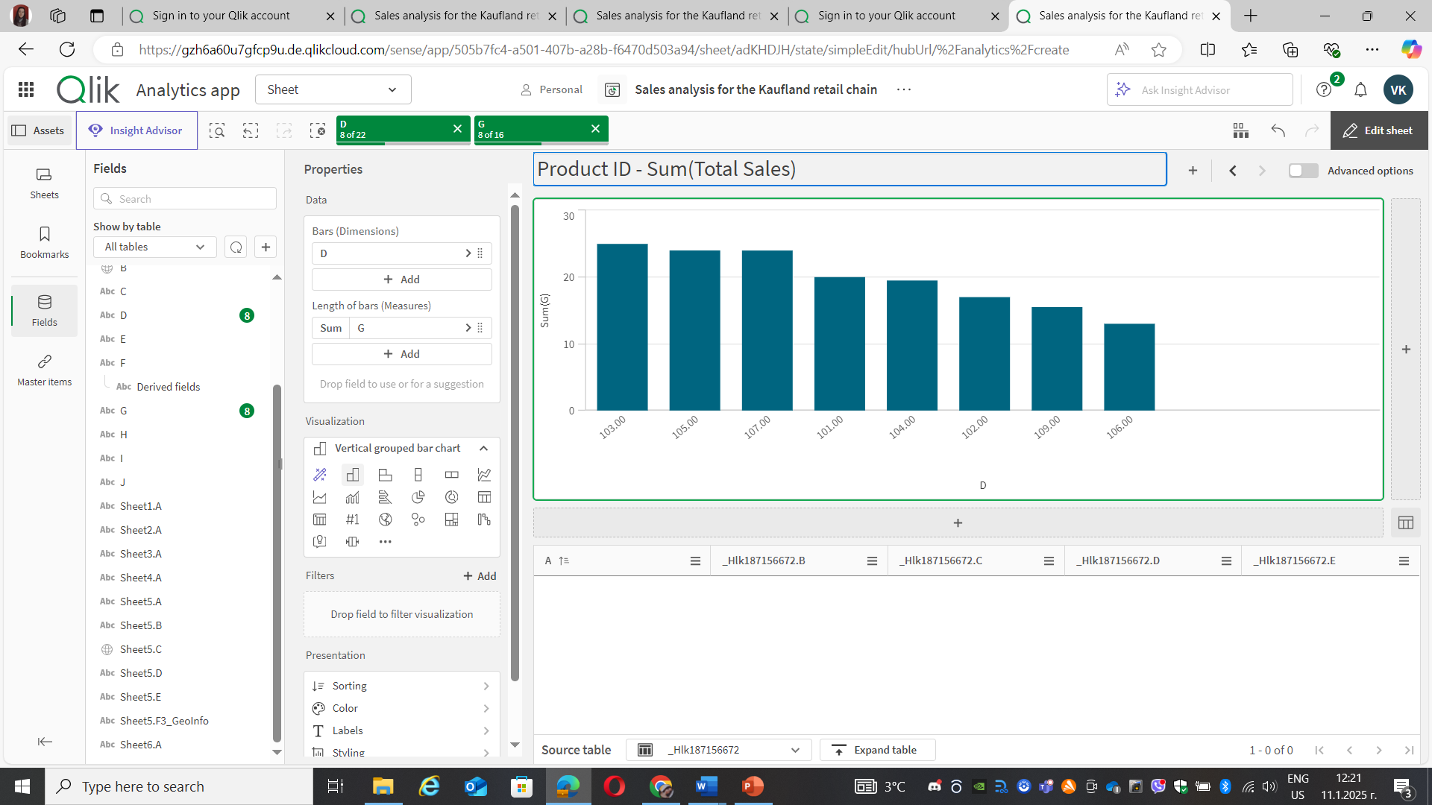
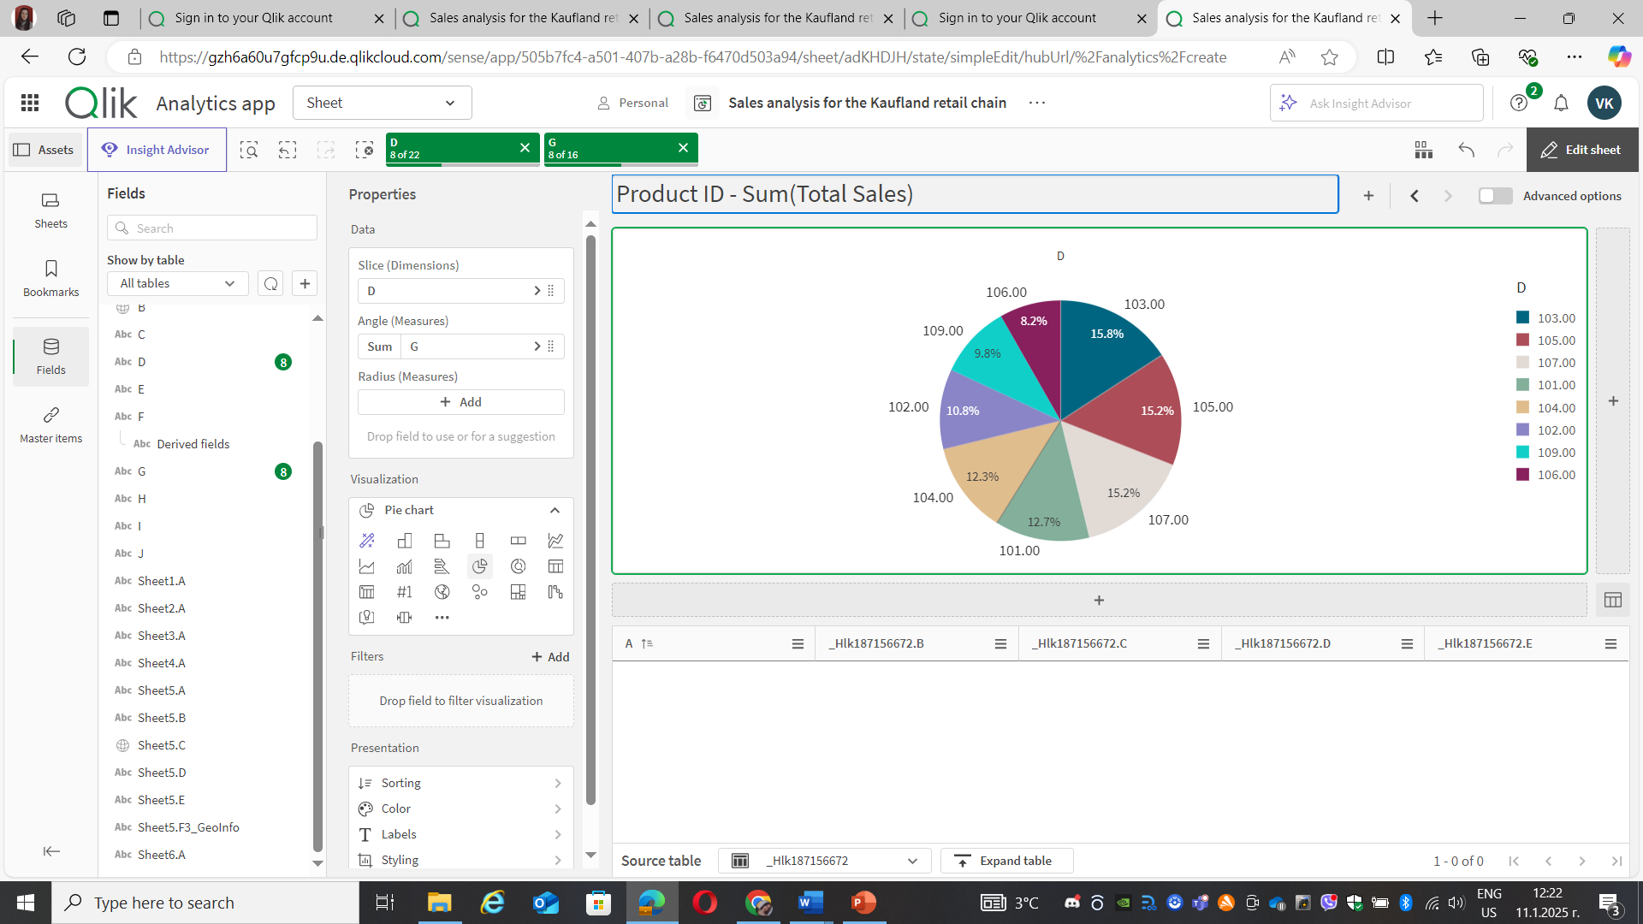
General Dashboard: vision and features
Best sellers by product

Slide 17
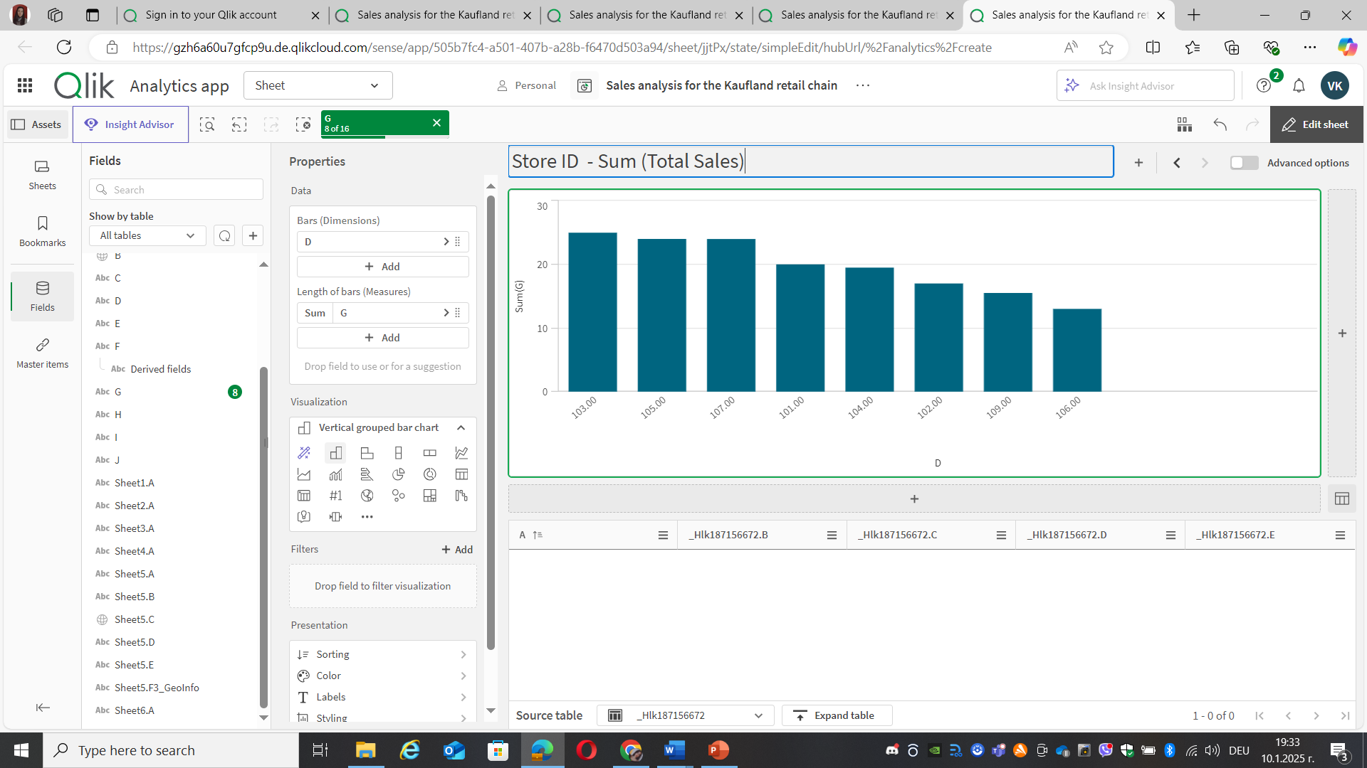
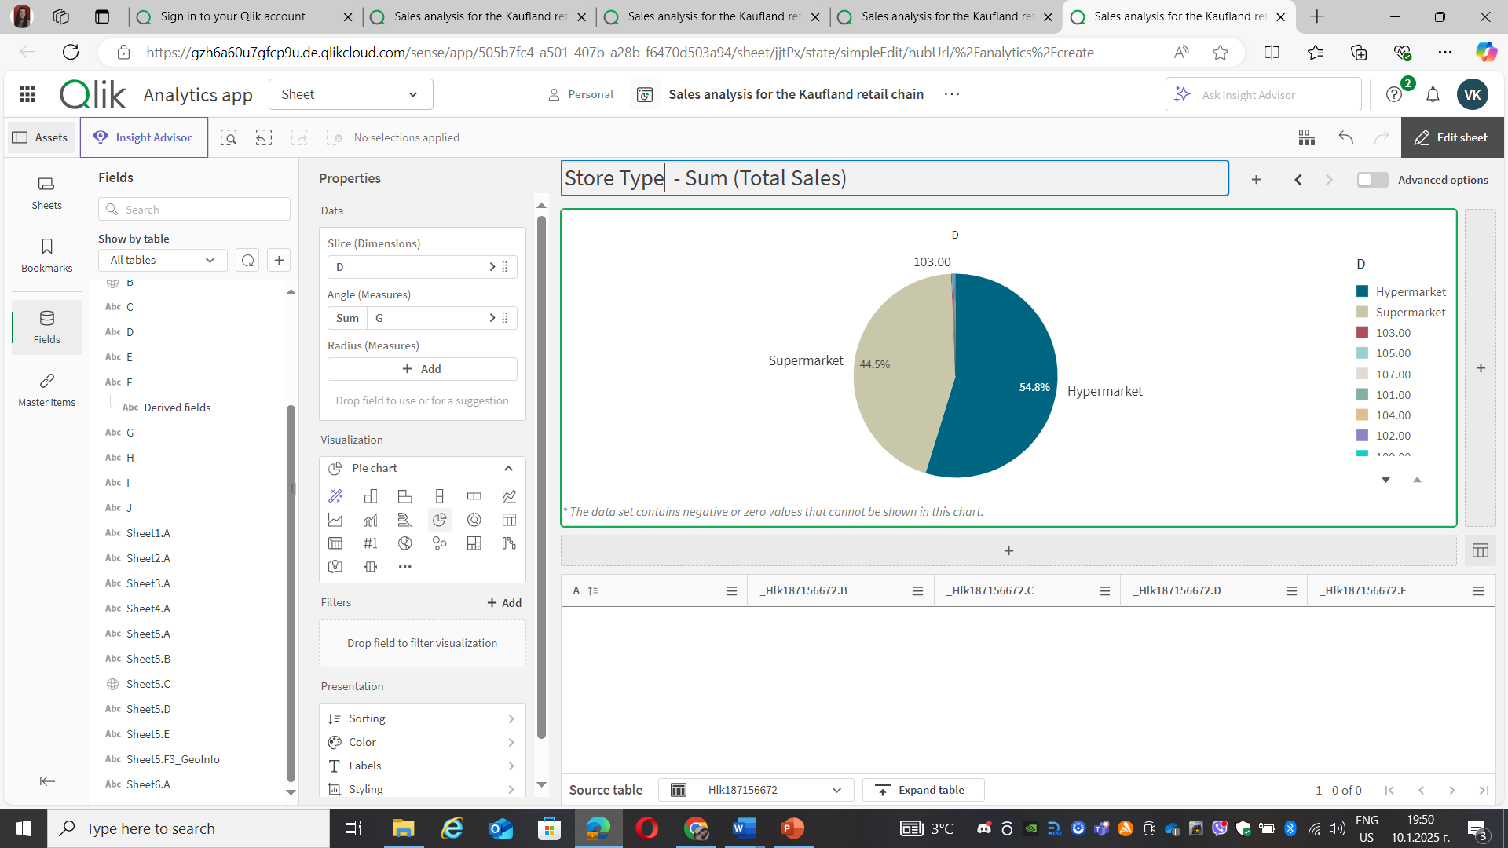
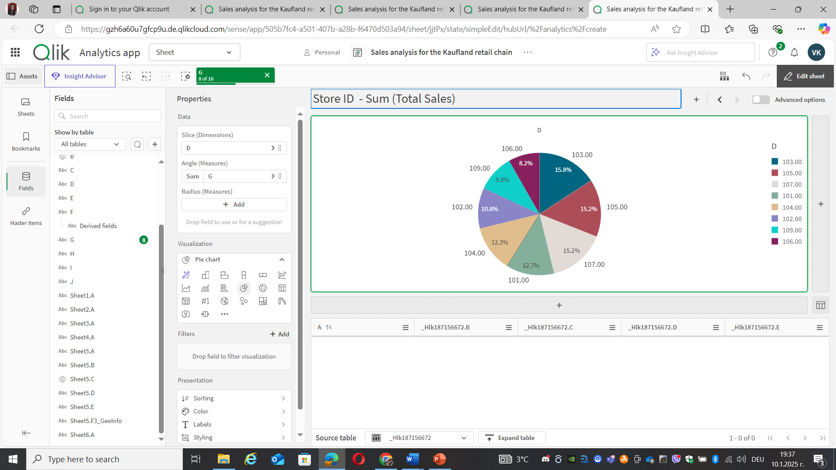
General Dashboard: vision and features
Difference in sales between large hypermarkets and smaller stores

Slide 18
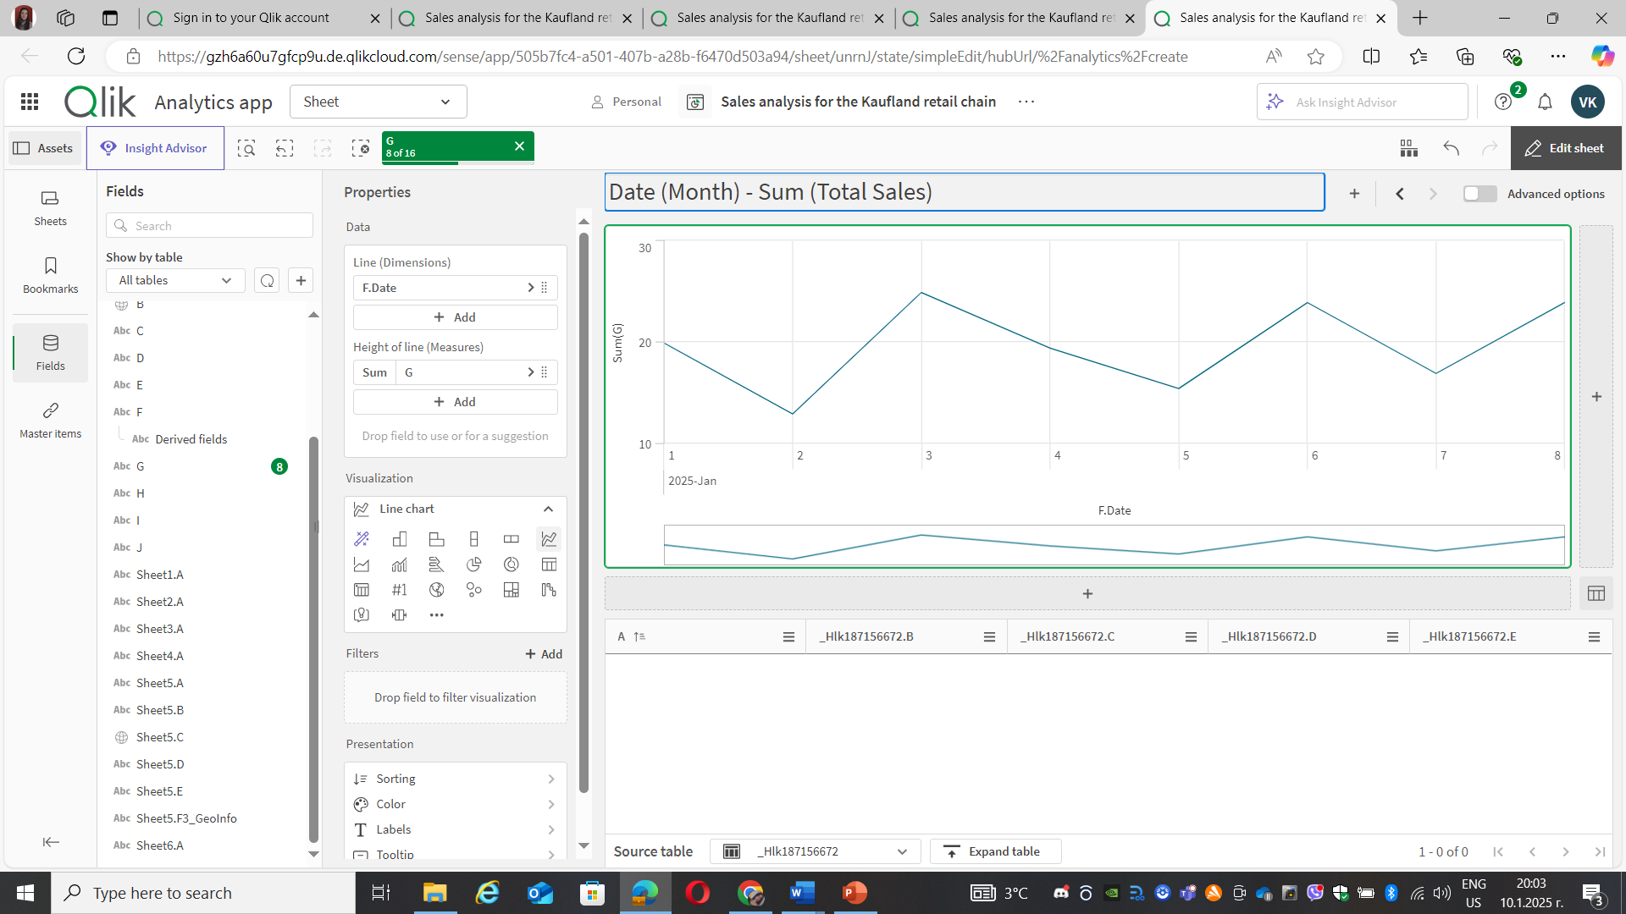
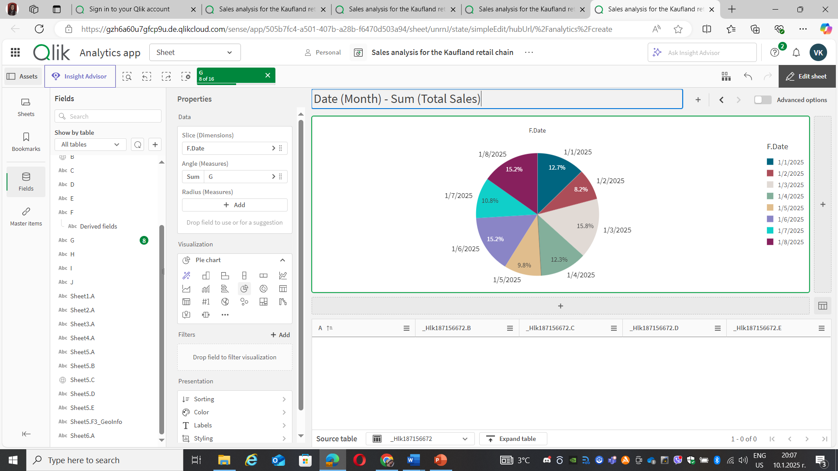
General Dashboard: vision and features
Trends in Food vs. Non-Food Items

Slide 19
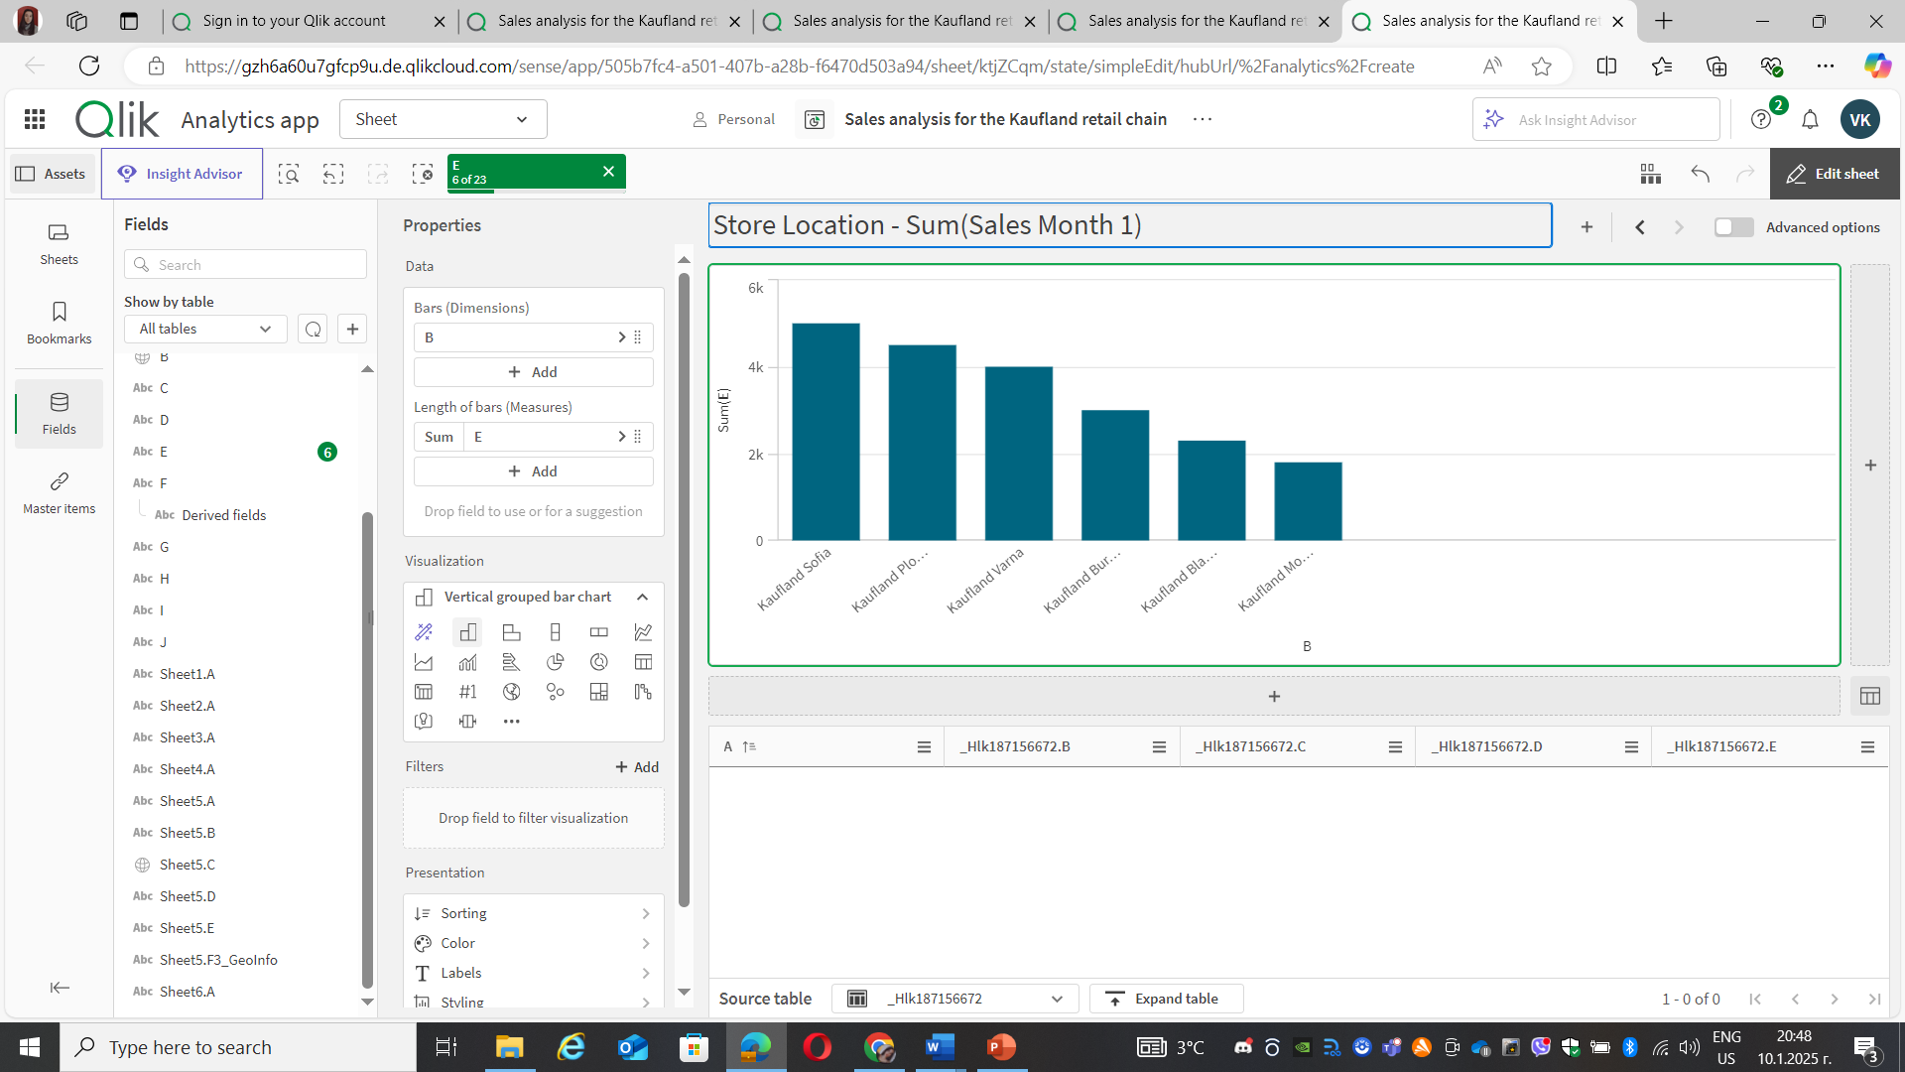
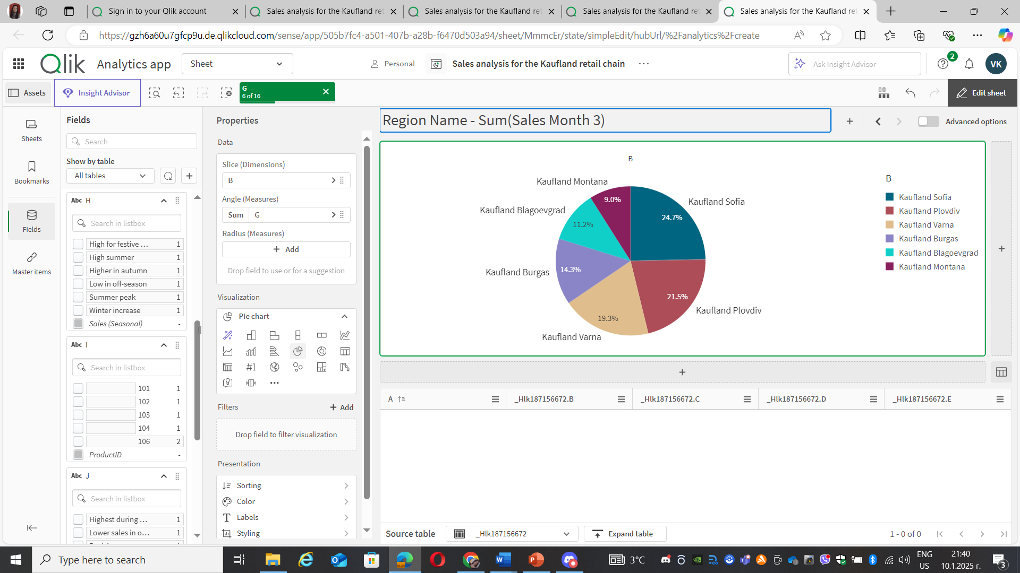
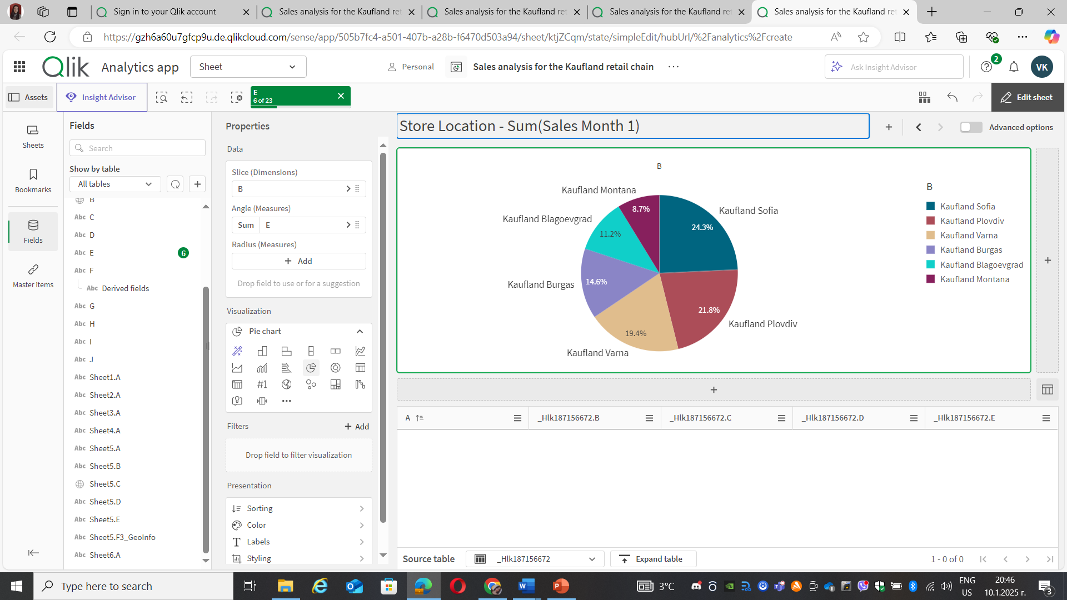
General Dashboard: vision and features
Best sellers by Region name(Store location) during Month 1

Slide 20


General Dashboard: vision and features
Best sellers by Region name(Store location) during Month 2

Slide 21


General Dashboard: vision and features
Best sellers by Region name(Store location) during Month 3

Slide 22
Analysis results and conclusions
Which categories of products are the best sellers and therefore what is the best selling product and which category does it belong to?
Bar chart: The category with the highest value (highest column) is category 2 (Bread and bakery products) and it probably contains the best-selling products.
Pie chart: Category 2 (Bread and bakery products) and Category 1 (Fresh fruit and vegetables) took the top positions with the highest percentages (23.4%). The best selling product (15,8%) is product ID 103 (Olives).

Slide 23
Analysis results and conclusions
What is the difference in sales between large hypermarkets (in big cities) and smaller stores in the Kaufland network?
The pie chart shows that hypermarkets dominate with approximately 55% of sales compared to 45% for supermarkets.
The bar chart provides more detail on total sales by different store types or regions.

Slide 24
Analysis results and conclusions
What are the trends in Kaufland's food versus non-food items?
Non-food sales are significantly lower than food sales, which is to be expected for a chain such as Kaufland that is primarily food-focused.
The line graph shows monthly variations in sales, with peaks in food products at periods such as holidays (e.g. Christmas or Easter). This highlights their seasonal dependence.
Non-food products show a smoother trend with no sharp peaks, which may indicate less influence from seasonality and campaigns for these items.

Slide 25
Analysis results and conclusions
What are the seasonal patterns in Kaufland's sales?
The largest share of sales was made in July (15.2%) and June (15.1%), which can be explained by higher consumer activity during the summer period, including summer holidays and picnic seasons.
The lowest proportion of sales was observed in March (8.2%), suggesting a relatively weak season in terms of demand.
The remaining months have similar percentages, ranging from about 10.8% to 15%, suggesting an even distribution with the exception of certain peak or weaker months.

Slide 26
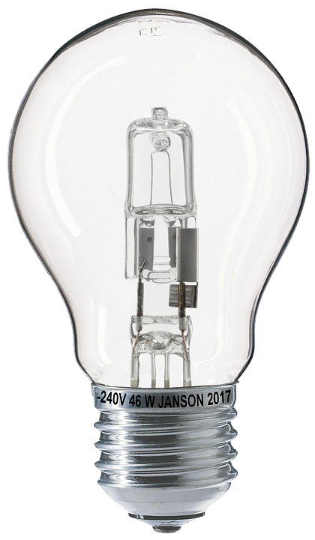
Analysis results and conclusions
Which are the leading regions by sales in the first month and what are their shares in total sales?
The top region according to sales is Kaufland Sofia with the largest share in sales - 24.3%, making it the leading region for the first month. It was followed by Kaufland Plovdiv (21.9%) and Kaufland Varna (19.4%).
Weaker sales show the lowest sales figures are in Kaufland Montana, whose share is only 8.7%.
The conclusion is that sales in the largest cities (such as Sofia, Plovdiv and Varna) dominate, but smaller locations, such as Montana, are significantly behind. Therefore, if more promotions are targeted to areas like Montana, they could significantly increase sales there.
The conclusions for the next 2 months are similar to the first.

Slide 27
Thank you for your attention!
Contacts: vesela_krumova20@abv.bg; vkrumova@tu-sofia.bg

